Slide 1
Welcome to Year 5
We are Attlee and Chavasse

Slide 2
Year 5 Team
Miss Kinsey-Jones – Class Teacher – Chavasse
Mr Robinson – Class Teacher – Attlee / Upper Phase Leader (KS2)
Miss Conway/Miss Atkinson – Learning Support Officer
Miss Shacklady - Additional Needs Support Assistant
Mr Whorton and Mr Nelson – PE
Mr Smith – Computing

Slide 3
English in Year 5
Key texts, high quality
Spellings – Weekly spellings on Spelling shed
Expectations of presentation – children should be working towards joined handwriting. Please refer to Handwriting Policy on the school website.
Writing for a purpose – we endeavour to make links to our class text to enable writing to have a clear purpose
Key text – James and The Giant Peach
Reading – Weekly whole class text and independent comprehension / independent reading with teacher

Slide 4
End of Year expectations (on website)
Reading:
Decoding/ Phonics | Read words automatically if they are very familiar. Decode words quickly and silently because their sounding and blending routine is now well established.
Prediction, inference & deduction | Reads ahead to help with fluency & expression. Comments on plot, setting & characters in familiar & unfamiliar stories. Recounts main themes & events. Comments on structure of the text.
Intonation and Expression | Use commas, question marks & exclamation marks to vary expression. Read aloud with expression & intonation
Grammatical Features | Recognise: - speech marks - contractions Identify past/present tense.
Research | Use contents page and index to locate information.

Slide 5
End of Year expectations (on website)
Writing:
Sentence & text structure | Demarcate most sentence with capital letters and full stops and use question marks correctly. Use expanded noun phrases to add description & specification. Write using co-ordination ( or, and, but ) and some subordination (when, if, that, because). Correct & consistent use of present tense & past tense. Correct use of verb tenses.
Punctuation | Correct & consistent use of: Capital letters. Full stops. Question marks. Exclamation marks. Commas in a list. Apostrophe (omission).
Paragraphing | Write under headings [as introduction to paragraphs].
Handwriting | Evidence of diagonal & horizontal strokes to join

Slide 6
Maths
We use Maths No Problem which uses Singapore Maths
methodology.
https://mathsnoproblem.com/en/parent-videos/
Areas of learning this term –
Place Value: Numbers to 100, Number Bonds and Number Patterns
Addition and Subtraction: Number bond diagrams, continue with the
standard column method
Multiplication: Multiplication as equal groups, times tables, factors and __multiples
Presentation of work – Children are expected to take care of their workbooks and present their work neatly, numbers orientated correctly.
Basic Skills – Daily maths workouts to revisit and embed underlying Maths skills needed to access the Year 5 curriculum - this will be done in smaller groups.

Slide 7
End of Year expectations (on website)
Maths:
Counting & ordering | Compare & order numbers up to 100.
Numbers & more/less | Read & write all numbers to 100 in digits & words. Say 10 more/less than any number to 100.
Tables & multiples | Count in multiples of 2, 3 & 5 & 10 from any number up to 100. Recall & use multiplication & division facts for 2, 5 & 10 tables.
Bonds & Facts | Recall & use +/- facts to 20. Derive & use related facts to 100.
Place value & rounding | Recognise place value of any 2-digit number.
Calculations +/- | Add & subtract: o 2-digit numbers & ones o 2-digit numbers & tens o Two 2-digit numbers o Three 1-digit numbers Recognise & use inverse.
Calculations x/÷ | Calculate & write multiplication & division calculations. Recognise & use inverse.
Fractions & percentages | Recognise, find, name & write ½ 1/3; 1/4; 2/4; 3/4. Recognise equivalence of simple fractions.
Measures | Read the time on a clock to the nearest 15 minutes. Use different coins to make the same amount.
Shape | Name and describe properties of 2D and 3D shapes, including side, vertices, edges, faces and lines of symmetry.

Slide 8
Homework
Comprehension – computer based reading comprehension (Google Classroom), set every Friday.
Maths Shed - games based on current learning, weekly assignments
Spelling Shed – computer based spelling games, weekly assignments.
TT Rock Stars – developing fluency in maths through games.
Learning Logs – Link to class work, supports learning. Children share their Learning Logs with classmates. This homework can be presented as writing, drawings, photographs or diagrams. Choose the best way for your child to learn.
(fortnightly 1st one this Friday)

Slide 9
Physical Education
September – October Half Term
Tuesday and Friday– remember to come to school wearing your P.E. uniform and trainers on these days.
October Half term – Christmas
Tuesday and Wednesday – children will be going swimming on a Wednesday morning.
Need to be in school by 8:45 to leave at 8:50
Towel, swimming costume, swim cap (all)

Slide 10
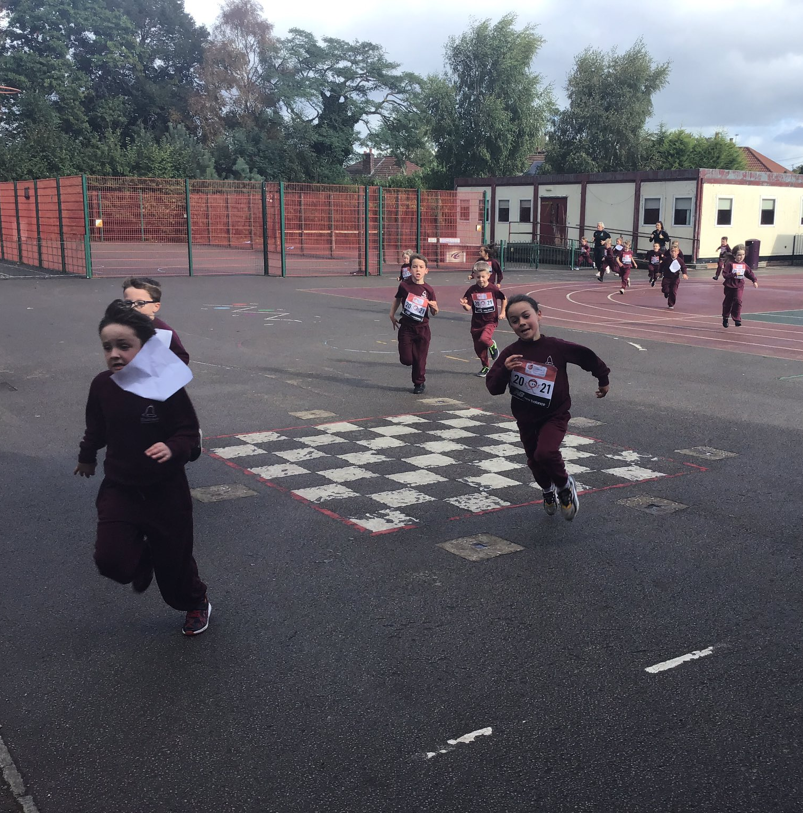
Healthy Minds
Water bottles – children have access all day.
Morning snack – playtime.
Milk – Children can choose to have milk. There is a payment, please use the online system.
Healthy School Meals – Menus online.
Healthy lunchboxes – if your child has a packed lunch please ensure they have a healthy and balanced selection.

Slide 11
Behaviour
Positive behaviour rewards –
Marbles in jar & Dojo points
Star of the Week & Work of the Week
Hot Chocolate – awarded to class inspiration by peers
NEW
Homework Rewards
Shout Outs
Phase leader – Mr Robinson

Slide 12
Curriculum Overview (this can be found on our year group webpage in downloads)

Slide 13
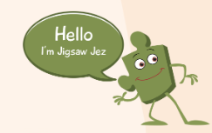
PSHE
PSHE scheme ‘ Jigsaw PSHE’ the children will take part in weekly lessons and assemblies based on the core themes.
https://www.rudstonprimary.co.uk/curriculum/pshe/

Slide 14
OUR CORE VALUES:
RESPONSIBILITY
RESPECT
RESILIENCE
CHALLENGE
ENJOYMENT

Slide 15
ARE YOU READY FOR YEAR 6 ??? This time next year you will be in a year 6 meeting and getting ready for the next stage of your learning journey – Year 5 is about getting you ready for that! Growing in responsibility … - Take responsibility for your own actions and behaviour (understand your impact on others) - Take responsibility for your own learning - Take responsibility for doing your homework - Take responsibility for your own belongings - Take Responsibility for …

Slide 16
Thank You
Ensure that you have connected via Arbor
Follow us on X (formerly Twitter) - @rudstony5
We look forward to getting to know you all!

