Slide 1
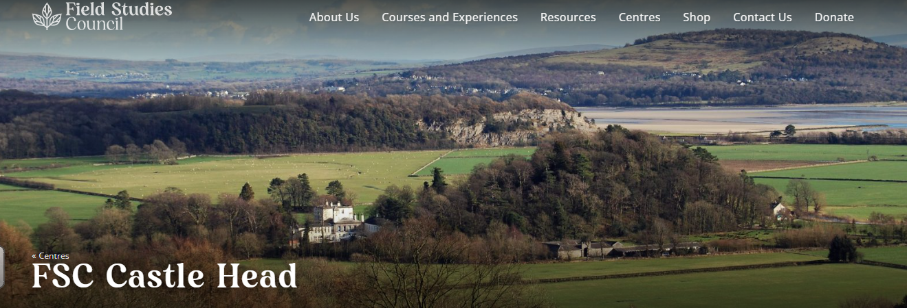
Year 5 Residential 20th to 22nd September 2023

Slide 2
FSC Castle Head a fantastic location for provides outdoor adventure! The centre is located in beautiful south Cumbria between the coast of Morecambe Bay and the Lake District National Park. With easy access to both the coastline of Morecambe Bay, the glaciated uplands of the southern Lake District and the lakes of Windermere and Coniston, Castle Head is ideally situated for a wide range of both field studies and adventurous activities.

Slide 3
The main purpose of the trip is to get the children involved and engaged in the outdoors, taking part in hands-on, safe experiences. Letting them enjoy wild adventures they will hopefully remember forever.
Increase interaction with nature, building confidence and resilience through activities and challenges
Encourage skills in communication and co-operation, with fun team-building games
Introduce measured risk taking to encourage independent thinking
Tackle the growing indoor culture which is adding to the UK’s nature deficit disorder.

Slide 4
Health and Safety Certificates held by the centre: Learning Outside the Classroom Quality Badge Carbon Trust Standard Adventure Activities Licensing Authority (AALA) licence Food Hygiene rating: 5* Investors in People Secondary Geography Quality Mark (Geographical Association) Primary Geography Quality Mark (Geographical Association) Green Tourism Award Green Apple Environment Award John Muir Award Safety Shield Health and Safety Award (Moorepay) Gold School Staff: Mr Robinson, Miss Kinsey-Jones, Mrs McElhinney, Mr Whorton, Miss Shacklady, Mrs Franklin School undertake a full LA risk assessment. Any required medication will be collected prior to the trip.

Slide 5
Timetable for our visit
Day/Date | Morning Session: 9.30am-12.30pm | Afternoon Session: 1.30pm-4.30pm | Evening Session: 6.30pm – 8.00pm or 7.00pm – 8.30pm
Wed 20th Sept | Arrival at: noon Introduction and tour of centre (Please bring your own packed lunch) | 1. Orienteering and Obstacle Course 2. Orienteering and Obstacle Course 3. Climbing Wall 4. Team Challenges 5. Team Challenges | 1. Night Trail 2. Night Trail 3. Camp Fire 4. Camp Fire 5. Climbing Wall
Thurs 21st Sept | 1. Raft Building 2. Raft Building 3. Orienteering and Obstacle Course 4. Climbing Wall 5. Orienteering and Obstacle Course | 1. Team Challenges 2. Climbing Wall 3. Raft Building 4. Raft Building 5. Raft Building | 1. Camp Fire 2. Camp Fire 3. Night Trail 4. Night Trail 5. Climbing Wall
Fri 22nd Sept | 1. Climbing Wall 2. Team Challenges 3. Team Challenges 4. Orienteering and Obstacle Course 5. Night Trail and Camp Fire | Departure at: 1pm

Slide 6
Meals are freshly prepared, with a hot breakfast, packed lunch (made by the children themselves) and choice of evening meal. Food is sourced locally wherever possible and caters for any dietary requirements.
All of our residential centres have been awarded the Soil Association’s Food for Life Served Here Bronze Award which recognises organisations which go the extra mile to make sure visitors are receiving healthy, nutritious and sustainable meals.

Slide 7
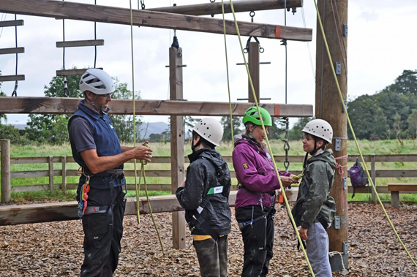
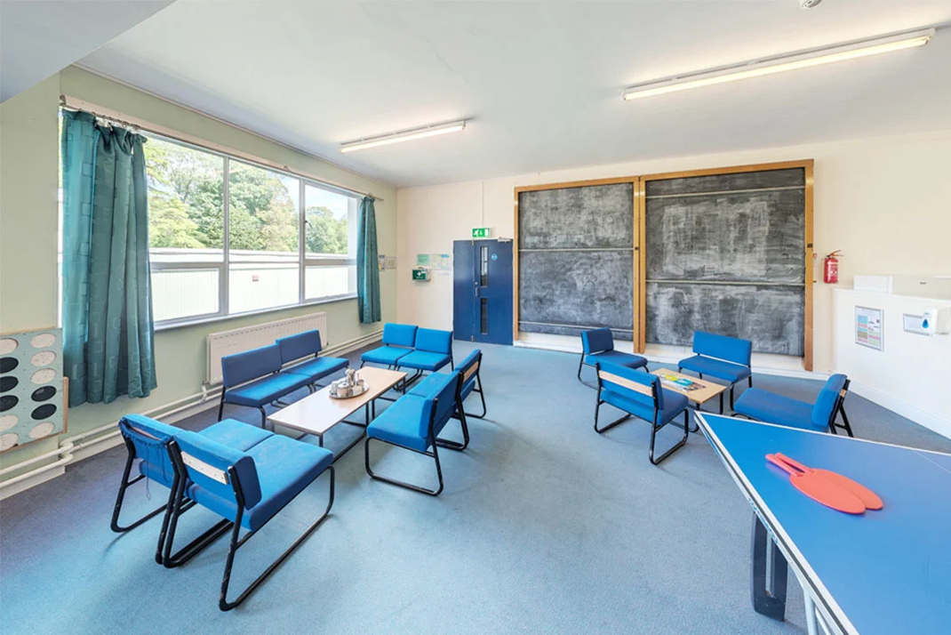

Slide 8
Sleeping Rooms have shower and toilet facilities close by. Children will be organised into rooms that include their friendship groups. There are also places to relax in at free time such as a lounge, games room and outdoor space.

Slide 9
Common Room: There are three common rooms; The Hillfoot Common Room (pictured) will be for our exclusive use during the stay.

Slide 10
What to take:
The activities continue even in heavy rain so a waterproof jacket of some sort will be necessary, as will strong footwear. The children will be able to change into dry, warm clothes for evening activities.
It is essential that ALL clothing is named, as there may be other schools staying, making it difficult to know where to return unnamed property.
Old clothes for all activities, including trousers and long sleeved tops, shorts and t-shirts – a range for every weather eventuality!
Trousers – at least one pair of which are not jeans, as jeans take a long time to dry!
2/3 pairs of shoes - sturdy shoes, a pair of old trainers, and shoes or trainers to change into if others are wet
Clothes for evening activities – these may involve being outside so items will need to be warm enough. e.g. tracksuit, sweatshirt, jumper, fleece top, etc.
Waterproof coat
Pyjamas
Socks and underwear – again, plenty of socks in case of soggy feet!
Bath towel and toiletries (no aerosols)
Bin bag for dirty clothes and carrier bag for dirty shoes
Suncream / sunglasses / gloves / hat
Water bottle
OPTIONAL: Rucksack for the journey
We insist that the children do not bring mobile phones, iPods, jewellery, sweets or digital cameras (although labelled disposable cameras are allowed). Books, notepads and small games would be welcomed for the journey and before bedtime. Children are responsible for these items – the trip or centre insurance does not cover them!
A full kit list will be sent out via the parent app following this meeting.

Slide 11
Any medication that your child requires (including travel sickness medication for return journey) should be handed to Mr Robinson on or before departure day in a labelled bag with clear instructions for dose and frequency attached, and a spoon or measure.
Ideally, please speak to Mr Robinson or Miss Kinsey-Jones regarding your child’s medical needs at a suitable time before our trip.
Please return the medical forms even if they do not require any medication.
Children who need to take travel sickness tablets should take them prior to coming to school before our departure on Wednesday 20th September so that the named box can also be given-in, in readiness for the return journey.
If you have any other questions regarding kit, medication or anything else, please do not hesitate to contact us.

